Slide 1
Calculation Speed comparision between python & C Additional algorithm analysis
Mert C. Kilic
Computer Engineering Junior Class (3rd year)

Slide 2
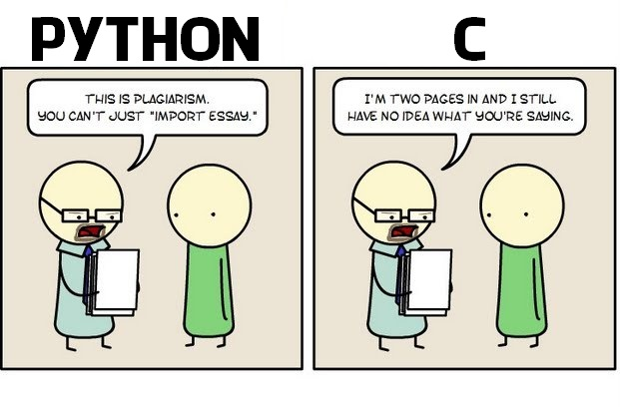
Why Python ? Why C ?

Slide 3
Overview
Python vs C technical Comparision
Python Perspective
C Perspective
Analysis of Some Algorithms (both code and timing)
Results
Screenshots
Graphical charts
Conclusion

Slide 4
Python
Python is a general-purpose, interpreted high-level programming language whose design philosophy emphasizes code readability. Its syntax is said to be clear and expressive.
Python has a large and comprehensive standard library. Similar to other scripting languages, these features make Python programmers more productive than C, C++ and Java programmers. [1]
Easy to code

Slide 5
ANSI C
ANSI (American National Standards Institute) C ; Any program written only in standard C and without any hardware dependent assumptions is virtually guaranteed to compile correctly on any platform with a conforming C implementation.[2]
Hard to implement but allows you to access on hardware easily.

Slide 6
General Idea
Python is a very popular interpreted scripting language. C is a very popular compiled language. Due to its compiled nature, C is generally faster than Python, but is lower-level, making Python programming quicker and easier than C programming. The questions here are whether or not the extra time taken to run a Python program (without input) will be less cost-effective than its C equivalent and whether runtime time is more important than programming time.
And this will be the AIM of this presentation as well as measuring time on some certain algorithms in both of languages !

Slide 7
Let us Begin !
In this presentation following algorithms will be the ones that are going to used for analysis;
2 over X
Quick Sort
Matrix Multiplication
Towers of Hanoi

Slide 8
Some Remarks
2 over x’s running time O(n)
Quick Sort’s running time O(nlogn)
Matrix Multiplication’s running time O(n^3)
Towers of Hanoi O(2^n)

Slide 9
Some knowledge about measurement environment
All functions in Python have been implemented in seperated .py file which are basically barebone structures.

Slide 10
Some knowledge about measurement environment
File called timeFuncs.py has other functions inside such as measureQsort(int x), measureHanoi(int q) etc. which integer part defines the number of repetition for more accurate results.

Slide 11
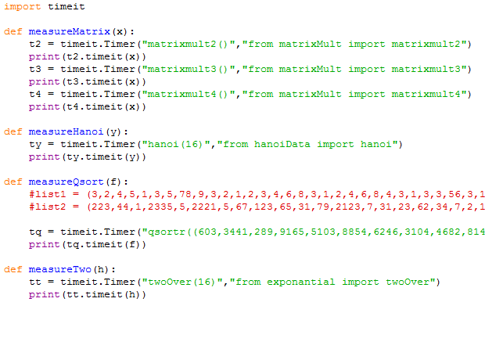

Slide 12
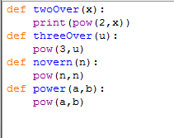
Python : 2 Over X

Slide 13


Python : 2 Over X cont.
1st
2 over 4
2.2032134465 for 1000 times
26.226411266 for 10000 times
2nd
2 over 16
4.19152503016 for 1000 times
45.8330539304 for 10000 times

Slide 14
Python : 2 Over X cont.
As we can easily see from the graph power function is linear in this case.

Slide 15

Python : Quick Sort

Slide 16
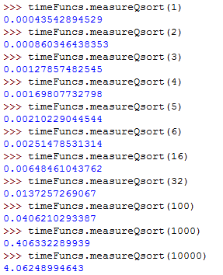
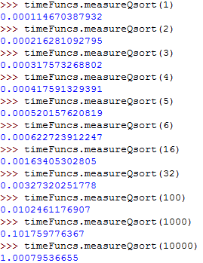
Python : Quick Sort cont

Slide 17
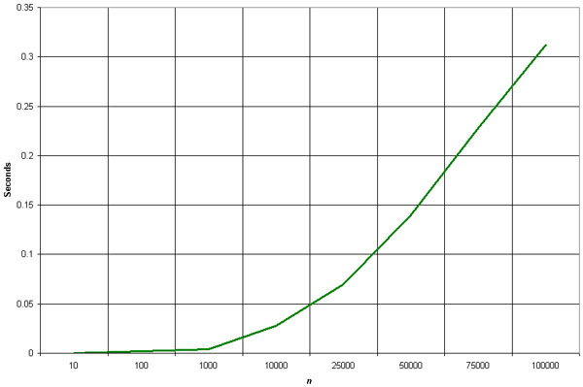
Python : Quick Sort cont

Slide 18
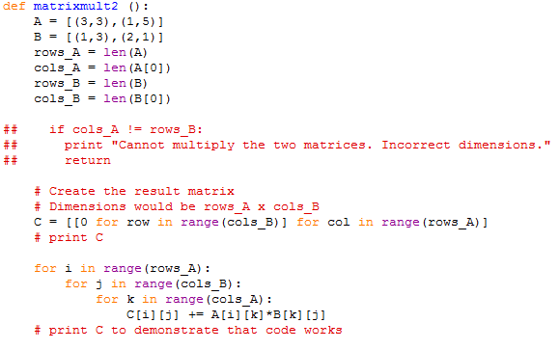
Python : Matrix Multiplication

Slide 19
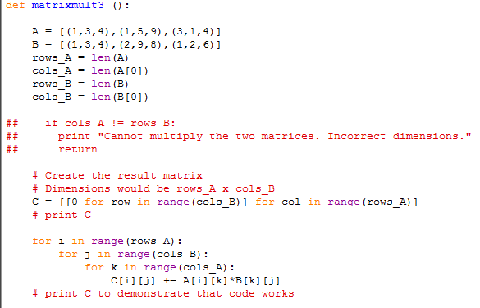
Python : Matrix Multiplication

Slide 20
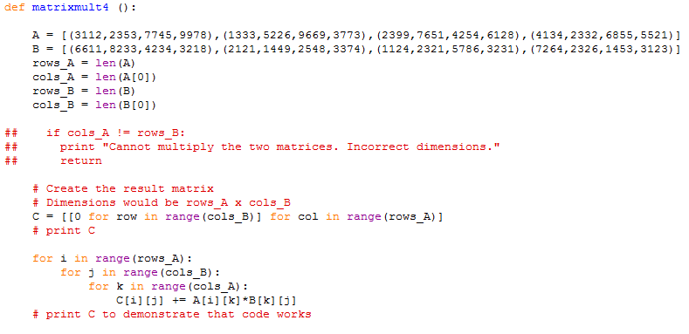
Python : Matrix Multiplication

Slide 21
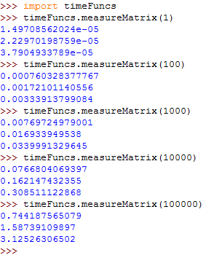
Python : Matrix Multiplication

Slide 22
Python : Matrix Multiplication
Its clear that those 2 graphs are not quite equal to each other which means theoretical algorithm analysis and actual implementation may not be the same all the time.

Slide 23
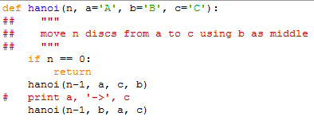
Python : Towers of Hanoi

Slide 24
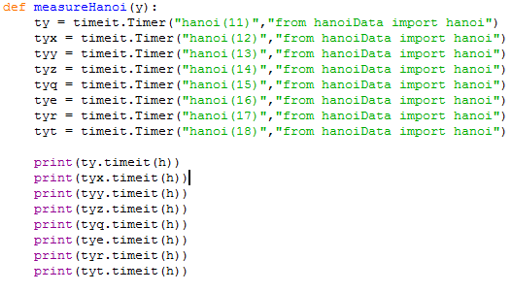
Python : Towers of Hanoi

Slide 25
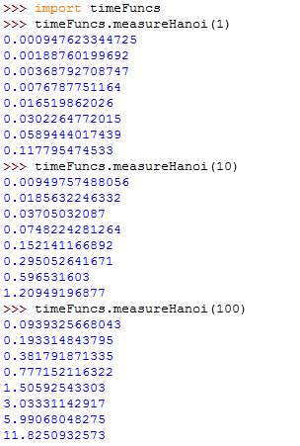
Python : Towers of Hanoi

Slide 26
Python : Towers of Hanoi

Slide 27
Lets take a look at C
Now all the measurements will be calculated under C coding.

Slide 28
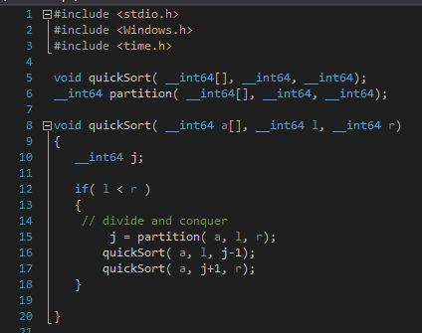
C : Quick Sort

Slide 29
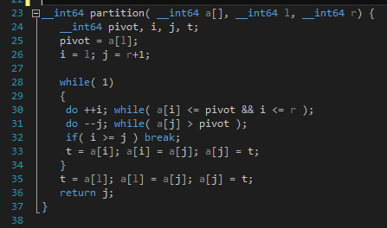
C : Quick Sort cont

Slide 30
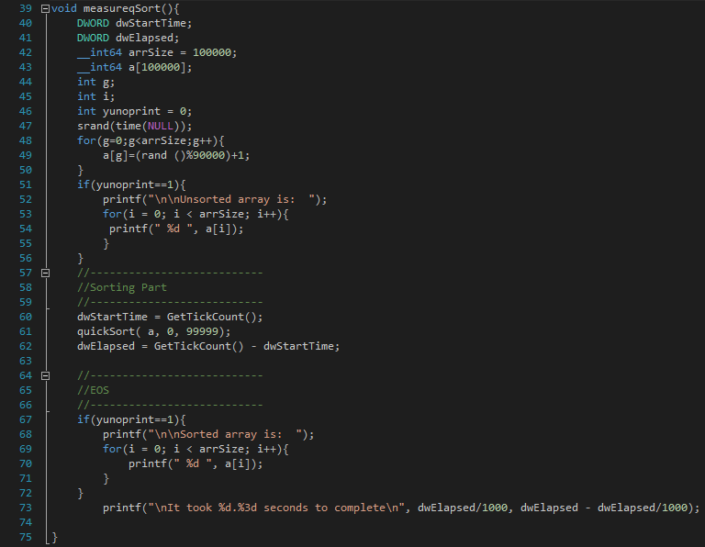

Slide 31
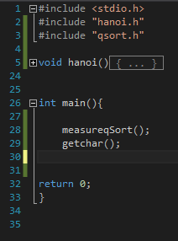
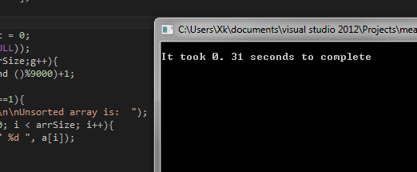
C : Quick Sort
REMARK !
In python implemantation for size 10k element in range 0 to 9999 it took 4.103 seconds
In C as you can see for array is large as 100k in range 0 to 9999 it took only 0.31 seconds

Slide 32
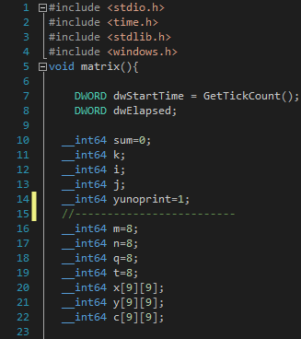
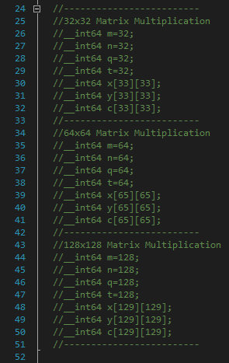
C : Matrix Multiplication

Slide 33
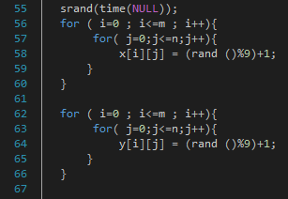
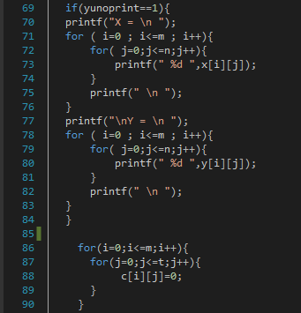
C : Matrix Multiplication

Slide 34
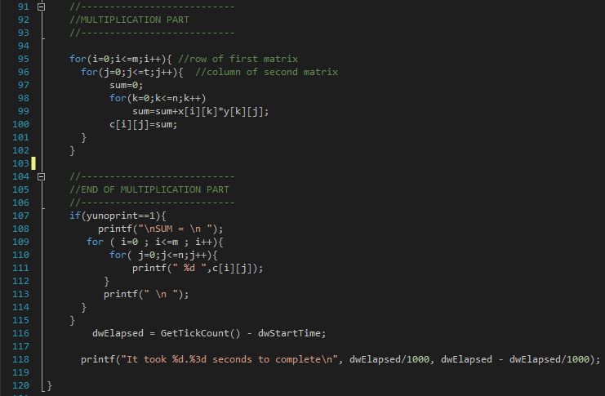
C : Matrix Multiplication

Slide 35
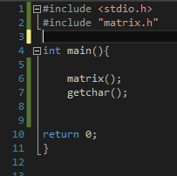
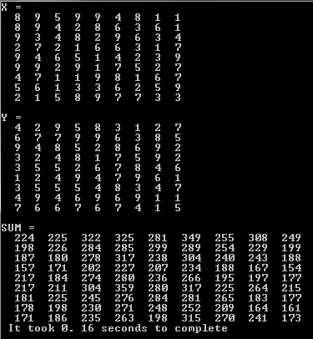
C : Matrix Multiplication
This example is multiplication of 2 – 9x9 arrays and it takes 0.16 seconds

Slide 36
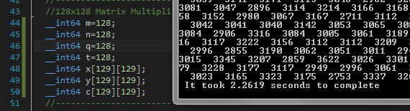
C : Matrix Multiplication

Slide 37
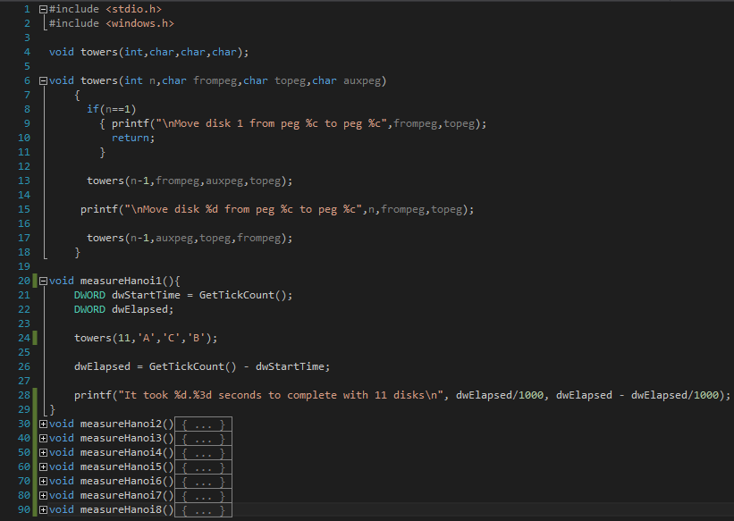
C : Towers Of Hanoi

Slide 38
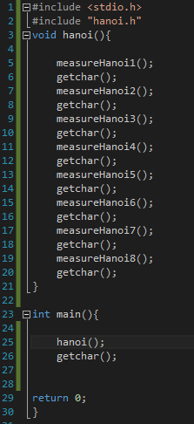
C : Towers Of Hanoi
Reminder : In Python Implemantation ;
Towers of Hanoi with
11 Disks takes 0.939 sec
12 Disks takes 1.933 sec
13 Disks takes 3.817 sec
14 Disks takes 7.777 sec
15 Disks takes 15.06 sec
16 Disks takes 30.33 sec
17 Disks takes 59.06 sec
18 Disks takes 118.2 sec
(Measurements may vary on the cpu that they are runned at)

Slide 39
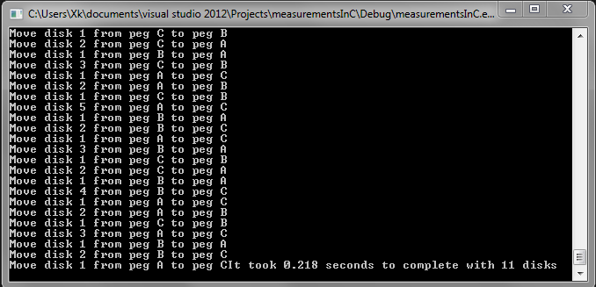
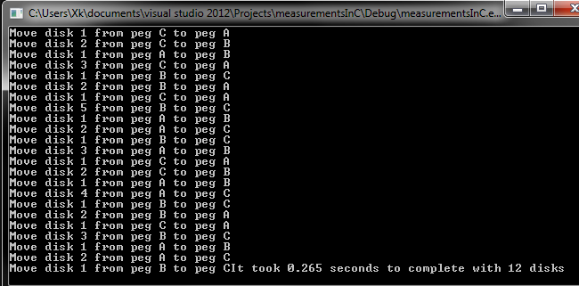
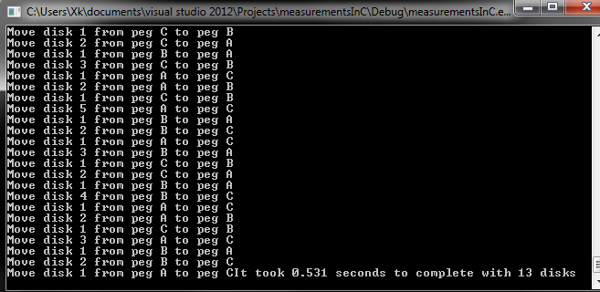
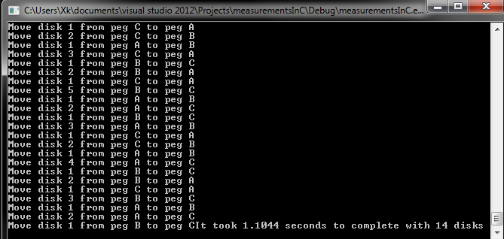
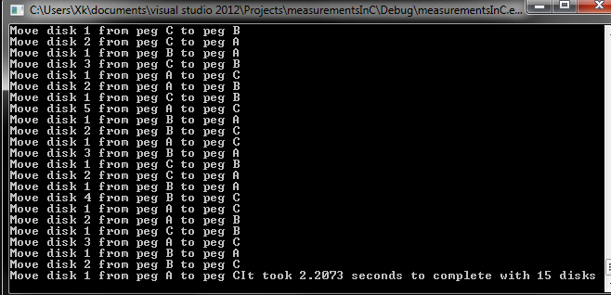
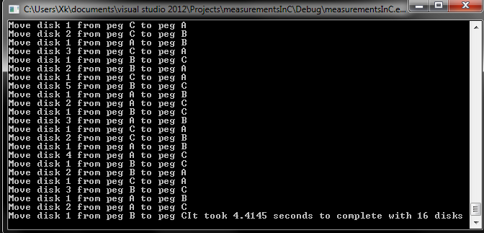
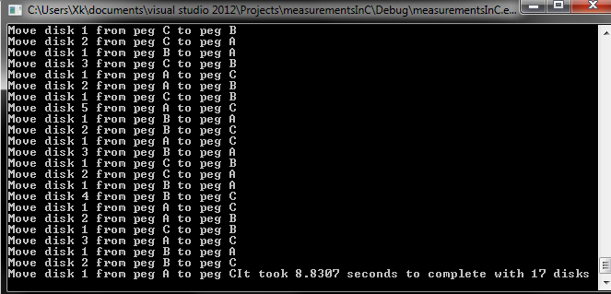
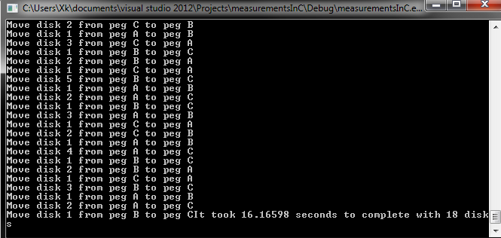
C : Towers Of Hanoi

Slide 40
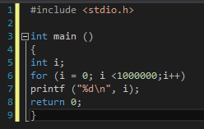

Last Comparasion
Simple but effective benchmark solution is “million problem”

Slide 41
Results
C real clock = 24.625 seconds user delay = 0.652 seconds system time = 2.240 seconds
Python real clock = 29.805 seconds user delay = 1.984 seconds system time = 1.812 seconds

Slide 42
Conclusion
As a conclusion of this presentation ;
First of all its over here ☺
Second its clear that in some certain areas predicted theoretical proofs are not always work on real life implementations.
Also its quite obvious C is much more effective and faster than Python but in the other hand it could be easier to code in python unless speed is not main concern.

Slide 43
Q & A
Any Questions ?

Slide 44
THANK YOU FOR LISTENING
ITS FINALLY OVER !

